Slide 1
Maharashtra Institute of Technology, Aurangabad. Department of Computer Science and Engineering (2022-23 Part-I) Major Project Review - 2 Flower Detection and Classification
Group Member: Guided by:
1)Ganesh Jamkar (59) Ms. D.R. Deshmukh
2)Arbaz Khan (54)
3)Amit Potdar (58)

Slide 2
Course Outcomes:
CO 1: Formulate problem statement based on real world problem.
CO 2: Analyze the collected system requirements.
CO 3: Apply suitable design methodology.
CO 4: Work efficiently in a team.
CO 5: Plan and organize the work by following project management techniques.
CO 6 :Effectively communicate technical information in presentation and writing by adhering to ethical principles.

Slide 3
Introduction
1.Now a day’s it is very important to identify naturally occurring objects and recognize its type.
2.It is useful to identify flower type in various fields such as Gardening, botany research, Ayurvedically treatment, Farming, floriculture etc.
3.Our literature survey must find that the different Image processing techniques used to extract features from flower and classify them using computational intelligence algorithms.
4.Digital image processing deals with manipulation of digital images through a digital computer. Digital image processing technologies such as Classification, Feature extraction, Pattern recognition etc. are useful to classify the images.

Slide 4
Problem statement:
Given a photograph of a flower, the aim is to identify the type of the flower using machine learning.
)

Slide 5
Literature survey
[1] Automated Flower Species Detection and Recognition from Digital Images, 2017 -> Aalaa Albadarneh and Ashraf Ahmad
[2] Flower Recognition System Based on Image Processing,2014 -> Tanakorn Tiay, Pipimphorn Benyaphaichit, and Panomkhawn Riyamongkol
[3] Flower Detection and Counting Using Morphological and
Segmentation Technique,2015 -> Balvant V. Biradar, Santosh P. Shrikhande

Slide 6
Feature Detection and Extraction
1) The flower recognition system based on image processing has been developed. This system uses edge and color characteristics of flower images to classify flowers.
2)Feature extraction helps to reduce the amount of redundant data from the data set.
3)The image is then cropped automatically by searching for the top, bottom, left, and right most extents of the flower position which are used to cut out the background of image.
1)Detect Features
detection is a low-level image processing operation. That is, it is usually performed as the first operation on an image and examines every pixel to see if there is a feature present at that pixel.
2)Extract Features
extraction refers to the process of transforming raw data into numerical features that can be processed while preserving the information in the original data set. It yields better results than applying machine learning directly to the raw data.
.

Slide 7
3)Match Features - Feature matching means finding corresponding features from two similar datasets based on a search distance.
4)Image Retrieval - An image retrieval system is a computer system used for browsing, searching and retrieving images from a large database of digital images.
5)Visualization and Display - Data visualization is a technique that uses an array of static and interactive visuals within a specific context to help people understand and make sense of large amounts of data. The data is often displayed in a story format that visualizes patterns, trends and correlations that may otherwise go unnoticed.
6)Store Features - A feature store is an emerging, ML-specific data system used to centralize storage, processing, and access to frequently used features, making them available for reuse in the development of future machine learning models.
7)Transform Objects - Data Transformation is the technique of converting data from one format to another.
8)Retrieve Images - An image retrieval system is a computer system used for browsing, searching and retrieving images from a large database of digital images.

Slide 8
Proposed system
IMAGE DATABASE
FEATURE
EXTRACTION
FEATURE
SELECTION
MACHINE LEARNING
(train/test)
CLASSIFICATION
PERFORMANCE
EVALUATION
Notes:
The proposed system
Image Dataset
Feature Extraction
Feature Selection
Machine Learning( Train/Test)
Classification
Performance Evaluation

Slide 9
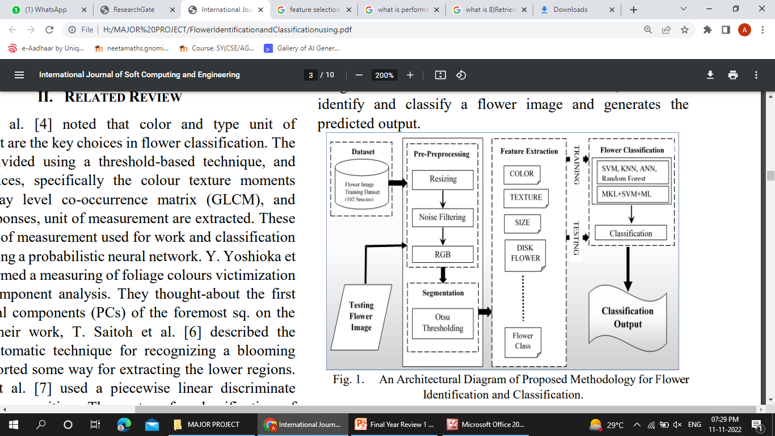

Slide 10
Image database.
An organized collection of digital images aimed at the efficient management and the processing of queries on this image collection Learn more in: Image Database Indexing Techniques.
IMAGE is based on the network database model, in contrast to most modern systems which are based on the relational database model.

Slide 11
Feature extraction
Feature extraction refers to the process of transforming raw data into numerical features that can be processed while preserving the information in the original data set. It yields better results than applying machine learning directly to the raw data.
Feature extraction helps to reduce the amount of redundant data from the data set. In the end, the reduction of the data helps to build the model with less machine effort and also increases the speed of learning and generalization steps in the machine learning process.

Slide 12
Feature selection
In machine learning and statistics, feature selection, also known as variable selection, attribute selection or variable subset selection, is the process of selecting a subset of relevant features
(variables, predictors) for use in model construction. Feature selection techniques are used for several reasons.
Feature Selection is the method of reducing the input variable to your model by using only relevant data and getting rid of noise in data. It is the process of automatically choosing relevant features for your machine learning model based on the type of problem you are trying to solve.

Slide 13
Machine learning train and test
>Train/Test is a method to measure the accuracy of your model.
>It is called Train/Test because you split the data set into two sets: a training set and a testing set.
>80% for training, and 20% for testing.
>You train the model using the training set.
>You test the model using the testing set.
>Train the model means create the model.
>Test the model means test the accuracy of the model.

Slide 14
Classification
The Classification algorithm is a Supervised Learning technique that is used to identify the category of new observations based on training data.
In Classification, a program learns from the given dataset or observations and then classifies new observation into several classes or groups.
Such as, Yes or No, 0 or 1, Spam or Not Spam, cat or dog, etc. Classes can be called as targets/labels or categories.

Slide 15
Performance Evaluation
In Machine Learning, the performance evaluation are used to calculate the performance of your trained machine learning models.
This helps in finding how better your machine learning model can perform on a dataset that it has never seen before.

Slide 16
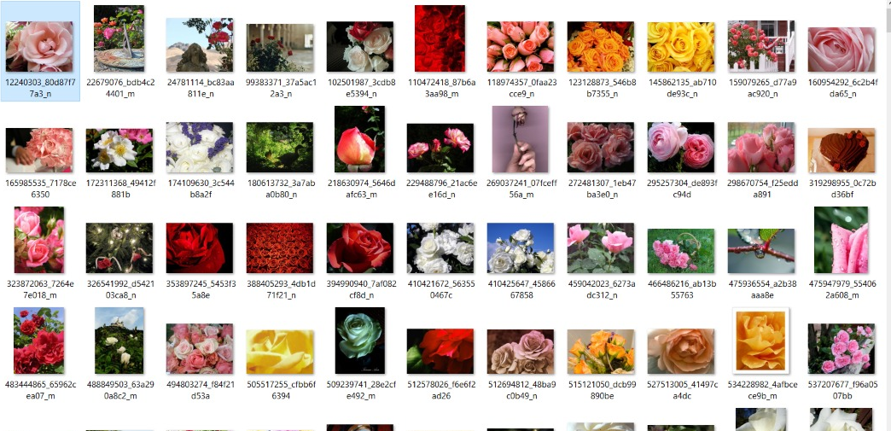
DATASET

Slide 17

PROJECT OUTPUT

Slide 18
REFERENCES
[1] M. Das, R. Manmatha, and E. M. Riseman, “Indexing flower patent images using domain knowledge”, IEEE Intell. Syst., vol 14, pp. 24-33, 1999.
[2] T. Saitoh and T. Kaneko, “Automatic recognition of wild flowers”, System and Computer in Japan, vol. 34, no. 10, 2003.
[3] M. E. Nilsback , and A. Zisserman, “A visual vocabulary for flower classification”, In CVPR, 2006.
[4] Y. Chai, “Recognition between a large number of flower species”, Master thesis, University of Oxford 2011
[5] https://www.kaggle.com/datasets/alxmamaev/flowers-recognition

Slide 19
Thank You.

